Slide 1

Data-Intensive Distributed Computing
CS 451/651 (Fall 2018)
Part 6: Data Mining (4/4)
November 6, 2018
Jimmy Lin
David R. Cheriton School of Computer Science
University of Waterloo
These slides are available at http://lintool.github.io/bigdata-2018f/
This work is licensed under a Creative Commons Attribution-Noncommercial-Share Alike 3.0 United States See http://creativecommons.org/licenses/by-nc-sa/3.0/us/ for details

Slide 2
Structure of the Course
Analyzing Text
Analyzing Relational Data
Analyzing Graphs
Data Mining
“Core” framework features and algorithm design

Slide 3
Theme: Similarity
How similar are two items? How “close” are two items?
Equivalent formulations: large distance = low similarity
Lots of applications!
Problem: find similar items
Offline variant: extract all similar pairs of objects from a large collection
Online variant: is this object similar to something I’ve seen before?
Last time!
Problem: arrange similar items into clusters
Offline variant: entire static collection available at once
Online variant: objects incrementally available
Today!

Slide 4
Clustering Criteria
How to form clusters?
High similarity (low distance) between items in the same cluster
Low similarity (high distance) between items in different clusters
Cluster labeling is a separate (difficult) problem!

Slide 5
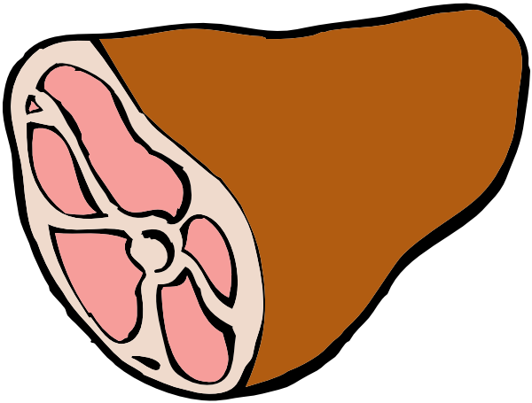

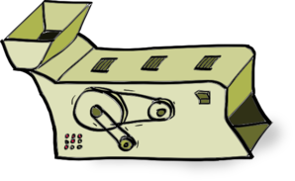
Supervised Machine Learning
training
testing/deployment
training data
Model
?
Machine Learning Algorithm

Slide 6
Unsupervised Machine Learning
If supervised learning is function induction…
what’s unsupervised learning?
Learning something about the inherent structure of the data
What’s it good for?

Slide 7
Applications of Clustering
Clustering images to summarize search results
Clustering customers to infer viewing habits
Clustering biological sequences to understand evolution
Clustering sensor logs for outlier detection

Slide 8
Evaluation
How do we know how well we’re doing?
Classification
Nearest neighbor search
Clustering
Inherent challenges of unsupervised techniques!

Slide 9
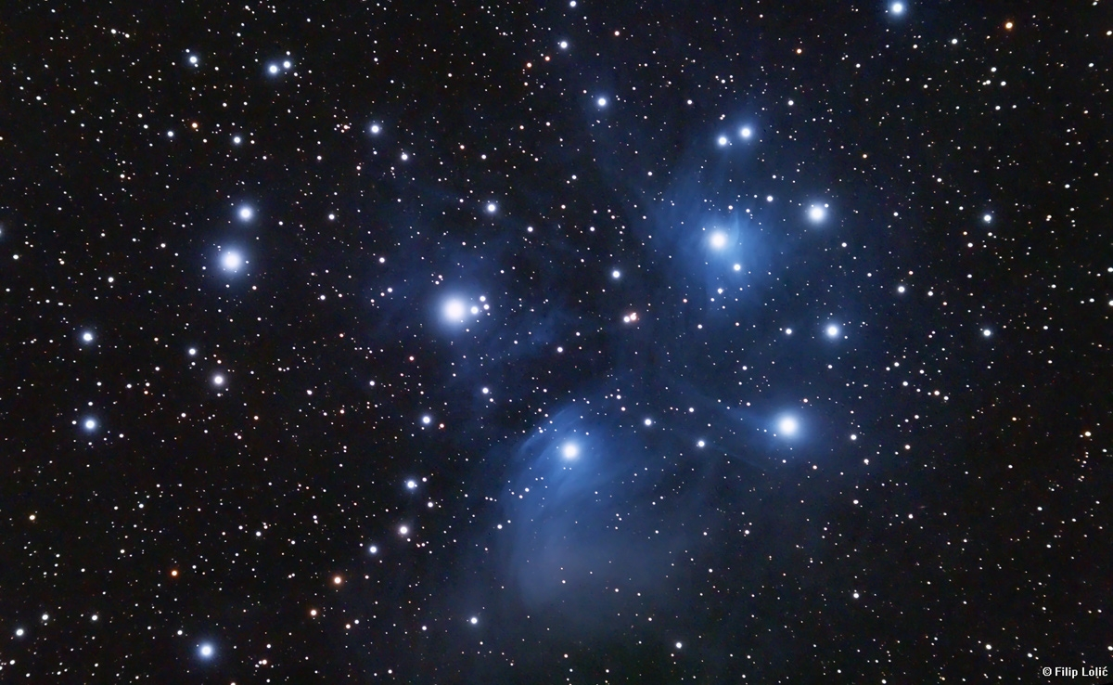
Clustering
Clustering
Source: Wikipedia (Star cluster)

Slide 10
Clustering
Specify distance metric
Jaccard, Euclidean, cosine, etc.
Compute representation
Shingling, tf.idf, etc.
Apply clustering algorithm

Slide 11

Distance Metrics
Source: www.flickr.com/photos/thiagoalmeida/250190676/

Slide 12
Distance Metrics
Non-negativity:
Identity:
Symmetry:
Triangle Inequality

Slide 13
Distance: Jaccard
Given two sets A, B
Jaccard similarity:

Slide 14
Distance: Norms
Given
Euclidean distance (L₂-norm)
Manhattan distance (L₁-norm)
L_{r}-norm

Slide 15
Distance: Cosine
Given
Idea: measure distance between the vectors
Thus:
Advantages over others?

Slide 16

Representations

Slide 17
Representations
(Text)
Unigrams (i.e., words)
Shingles = n-grams
At the word level
At the character level
Feature weights
boolean
tf.idf
BM25
…

Slide 18
Representations
(Beyond Text)
For recommender systems:
Items as features for users
Users as features for items
For graphs:
Adjacency lists as features for vertices
For log data:
Behaviors (clicks) as features

Slide 19
Clustering Algorithms
Agglomerative (bottom-up)
Divisive (top-down)
K-Means
Gaussian Mixture Models

Slide 20
Hierarchical Agglomerative Clustering
Start with each object in its own cluster
Until there is only one cluster:
Find the two clusters c_{i} and c_{j}, that are most similar
Replace c_{i} and c_{j} with a single cluster c_{i} ∪ c_{j}
The history of merges forms the hierarchy

Slide 21
HAC in Action
Step 1: {1}, {2}, {3}, {4}, {5}, {6}, {7}
Step 2: {1}, {2, 3}, {4}, {5}, {6}, {7}
Step 3: {1, 7}, {2, 3}, {4}, {5}, {6}
Step 4: {1, 7}, {2, 3}, {4, 5}, {6}
Step 5: {1, 7}, {2, 3, 6}, {4, 5}
Step 6: {1, 7}, {2, 3, 4, 5, 6}
Step 7: {1, 2, 3, 4, 5, 6, 7}
Source: Slides by Ryan Tibshirani

Slide 22
Dendrogram
Source: Slides by Ryan Tibshirani

Slide 23
Cluster Merging
Which two clusters do we merge?
What’s the similarity between two clusters?
Single Linkage: similarity of two most similar members
Complete Linkage: similarity of two least similar members
Average Linkage: average similarity between members

Slide 24
Single Linkage
Uses maximum similarity (min distance) of pairs:
Source: Slides by Ryan Tibshirani

Slide 25
Complete Linkage
Uses minimum similarity (max distance) of pairs:
Source: Slides by Ryan Tibshirani

Slide 26
Average Linkage
Uses average of all pairs:
Source: Slides by Ryan Tibshirani

Slide 27
Link Functions
Single linkage:
Uses maximum similarity (min distance) of pairs
Weakness: “straggly” (long and thin) clusters due to chaining effect
Clusters may not be compact
Complete linkage:
Uses minimum similarity (max distance) of pairs
Weakness: crowding effect – points closer to other clusters than own cluster
Clusters may not be far apart
Average linkage:
Uses average of all pairs
Tries to strike a balance – compact and far apart
Weakness: similarity more difficult to interpret

Slide 28
MapReduce Implementation
What’s the inherent challenge?
Practicality as in-memory final step

Slide 29
Clustering Algorithms
Agglomerative (bottom-up)
Divisive (top-down)
K-Means
Gaussian Mixture Models

Slide 30
K-Means Algorithm
Select k random instances {s₁, s₂,… s_{k}} as initial centroids
Iterate:
Assign each instance to closest centroid
Update centroids based on assigned instances

Slide 31
K-Means Clustering Example
Pick seeds
Reassign clusters
Compute centroids
Reassign clusters
◉
◉
Compute centroids
◉
◉
Reassign clusters
Converged!

Slide 32
Basic MapReduce Implementation
class Mapper {
def setup() = {
clusters = loadClusters()
}
def map(id: Int, vector: Vector) = {
context.write(clusters.findNearest(vector), vector)
}
}
class Reducer {
def reduce(clusterId: Int, values: Iterable[Vector]) = {
for (vector <- values) {
sum += vector
cnt += 1
}
emit(clusterId, sum/cnt)
}
}

Slide 33
Basic MapReduce Implementation
Conceptually, what’s happening?
Given current cluster assignment, assign each vector to closest cluster
Group by cluster
Compute updated clusters
What’s the cluster update?
Computing the mean!
Remember IMC and other optimizations?
What about Spark?

Slide 34
Implementation Notes
Standard setup of iterative MapReduce algorithms
Driver program sets up MapReduce job
Waits for completion
Checks for convergence
Repeats if necessary
Must be able keep cluster centroids in memory
With large k, large feature spaces, potentially an issue
Memory requirements of centroids grow over time!
Variant: k-medoids
How do you select initial seeds?
How do you select k?

Slide 35
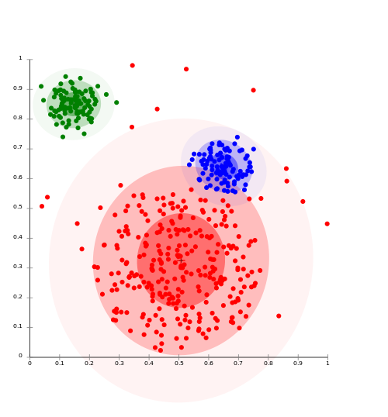
Clustering w/ Gaussian Mixture Models
Model data as a mixture of Gaussians
Given data, recover model parameters
What’s with models?
Source: Wikipedia (Cluster analysis)

Slide 36
Gaussian Distributions
Univariate Gaussian (i.e., Normal):
A random variable with such a distribution we write as:
Multivariate Gaussian:
A random variable with such a distribution we write as:

Slide 37
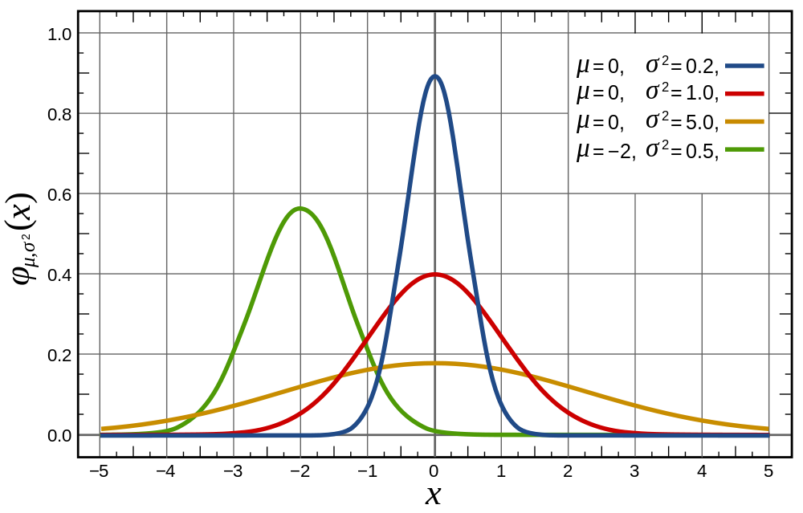
Univariate Gaussian
Source: Wikipedia (Normal Distribution)

Slide 38
Multivariate Gaussians
Source: Lecture notes by Chuong B. Do (IIT Delhi)

Slide 39
Gaussian Mixture Models
Model Parameters
Number of components:
“Mixing” weight vector:
For each Gaussian, mean and covariance matrix:
The generative story?
(yes, that’s a technical term)
Problem: Given the data, recover the model parameters
Varying constraints on co-variance matrices
Spherical vs. diagonal vs. full
Tied vs. untied

Slide 40
Learning for Simple Univariate Case
Problem setup:
Given number of components:
Given points:
Learn parameters:
Model selection criterion: maximize likelihood of data
Introduce indicator variables:
Likelihood of the data:

Slide 41
EM to the Rescue!
We’re faced with this:
It’d be a lot easier if we knew the z’s!
Expectation Maximization
Guess the model parameters
E-step: Compute posterior distribution over latent
(hidden) variables given the model parameters
M-step: Update model parameters using posterior
distribution computed in the E-step
Iterate until convergence

Slide 42
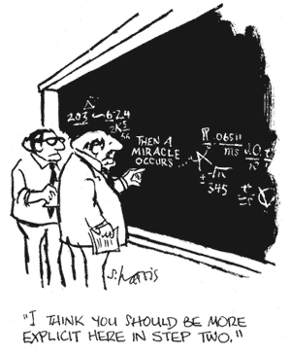

Slide 43
EM for Univariate GMMs
Initialize:
Iterate:
E-step: compute expectation of z variables
M-step: compute new model parameters

Slide 44
MapReduce Implementation
x₁
z_{1,1}
z_{1,2}
…
z_{1,K}
Map
x₂
z_{2,1}
z_{2,2}
z_{2,K}
x₃
z_{3,1}
z_{3,3}
z_{3,K}
…
x_{N}
z_{N,1}
z_{N,2}
z_{N,K}
Reduce
What about Spark?

Slide 45
K-Means vs. GMMs
K-Means
GMM
Map
Compute distance of points to centroids
E-step: compute expectation of z indicator variables
Reduce
M-step: update values of model parameters
Recompute new centroids

Slide 46
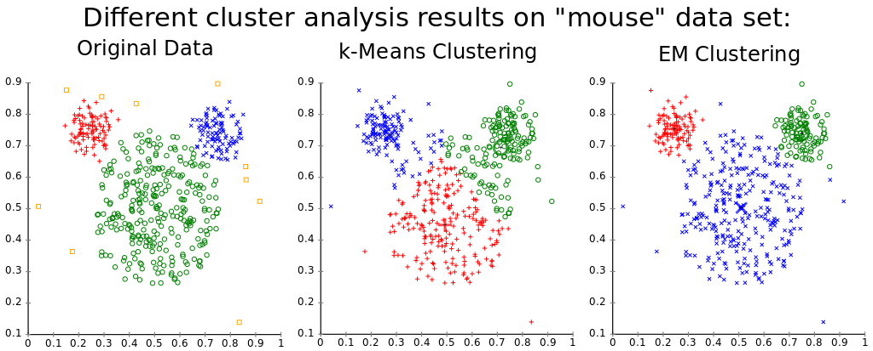
Source: Wikipedia (k-means clustering)

Slide 47

Source: Wikipedia (Japanese rock garden)

